Slide 1
Front End Engineering-I Project
Team Details:
Keshav Jindal (2310990713)
Khushi (2310990714)
Faculty Coordinator:
Dr. Harveen Kaur
:
Chitkara University Institute of Engineering and Technology,
Chitkara University, Punjab

Slide 2
Table of Contents
Introduction
Problem Statement
Technical Details
Key Features
Project Highlights
Conclusion
References/Links used

Slide 3
Introduction
TITLE OF THE PROJECT: FITNESS TRACKER
TEAM MEMBERS: KESHAV JNDAL
KHUSHI
PURPOSE OF OBJECT:
The purpose of a fitness tracker is to provide the user with instructions and examples of one or more types of exercise, physical activity, nutritional programs, or some other fitness topic.
To successfully create a fitness tracker application, whether the idea belongs to health or fitness, the overall web development process remains the same. The journey to create a user-centric website starts from the requirement gathering phase. This phase is closely associated with initial research as well.
For example, before a website is developed, one should have an idea about back-end structure, programming logic, understanding of the flow, data storage strategy, and more. By following agile methodology, one can launch a prototype and observe the market reaction. Hence, testing is an equally important aspect .
Popular Fitness Tracker Device Type
1. Smartphone
Smartphone offers a balanced set of hardware components for the fitness tracking app to operate. Such applications enable the user to gain insights into the daily fitness activities performed. For example, a fitness tracking app can record information on steps walked, the number of hours slept, burned calories, and others. After recording, the next important capability of such an app is displaying the data in a visually pleasing way. Fitness apps can be developed to show data, data charts, maps, and others to show the progress made by a user
2. Smartwatch
A smartwatch adds convenience in the life of a patient, fitness enthusiast, and others. Custom applications can be developed for Android or iOS-based smartwatches to address different pain points. Few such pain points include monitoring the cardiovascular health of a patient, urgent care required due to physical injury such as fracture, sharing patient’s health data seamlessly with clinics, and more.

Slide 4
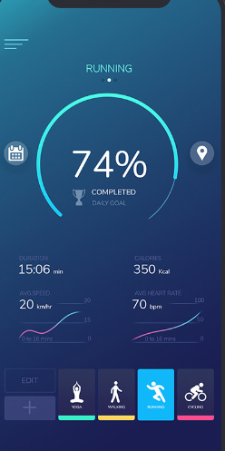
Problem Statement
Problem that the project aims to solve:
Step Tracker :One of the best parts is it helps to keep track of the progress which has been made over the long term.
Heart rate, calories: The more beats our heart has to take on a regular basis, the more strain it places on our heart over time
BMI Calculater: BMI provides a fairly reliable indicator of body fatness for most people and is used to screen for weight categories that may lead to health problems.
Workout plans: It gives consistency, increases fitness level, improves health, and generates a greater sense of mental well-being.

Slide 5
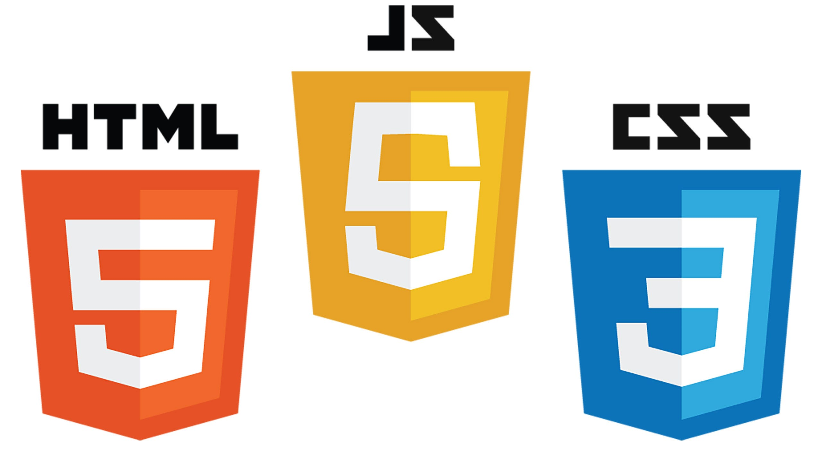
Technical Details
Here we used :
1.HTML:Hyper Text Markup Language
2.CSS:Cascading Style Sheet
3.Javascript
4.Bootsrap
By combining HTML ,CSS, Bootstrap and Javascript,We completed our project i.e.Fitness Tracker

Slide 6
Key Features
1.User Login
2.Diet Management
3.BMI calculater
4.Workout analysis
5.Terms and conditions
6.User support
7.Analytics and Report
8.Read more options

Slide 7
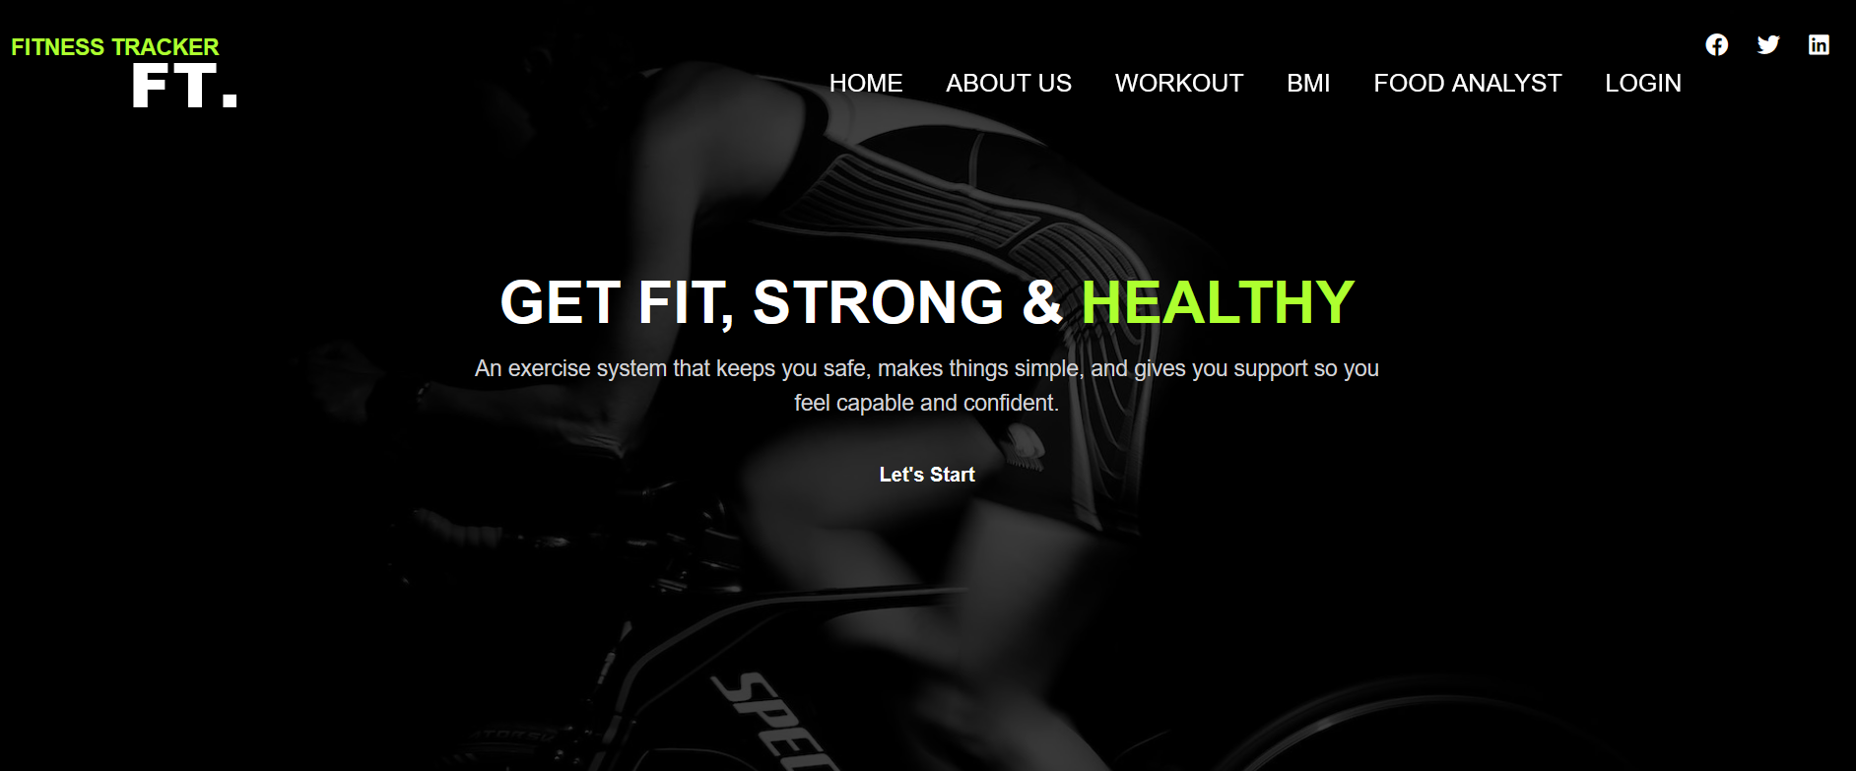
Project Highlights

Slide 8
v. Project Advantages
Advantages:
Accountability
A fitness tracker helps you exercise every day whether just walking, jogging or working out. You are more committed to get your steps in or complete your workout sessions.
Motivation
A fitness tracker gives a visual of your progress and accomplishments each day. Seeing your progress is good motivation to improve more and more each day.
Healthy eating
It is important to eat a healthy diet while you exercise. By keeping track of your food and water intake helps you maintain a healthy lifestyle.
Set goals
Set goals for yourself to accomplish each day. For example, 10,000 steps a day. It is a great feeling to know you are capable of achieving anything you set your mind to.

Slide 9
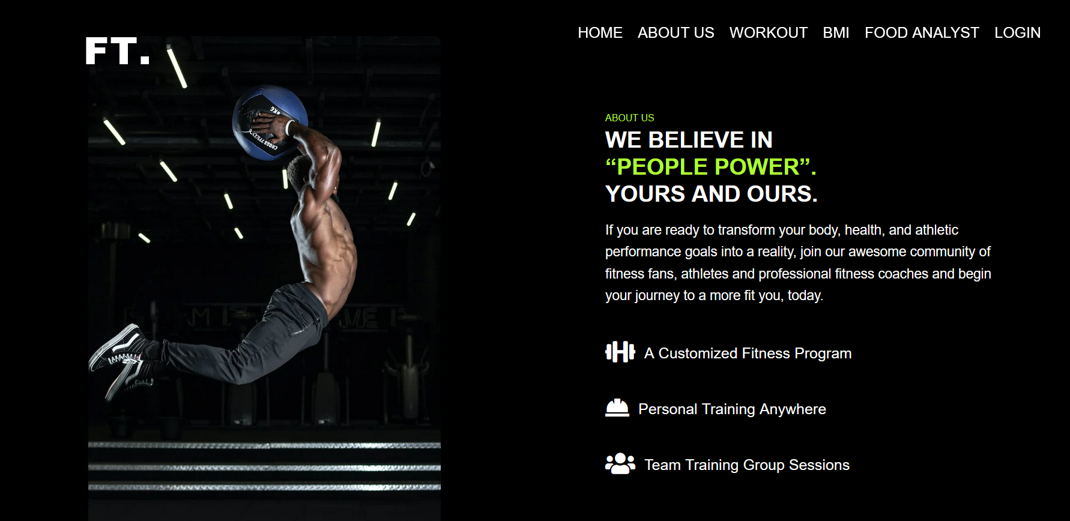

Slide 10
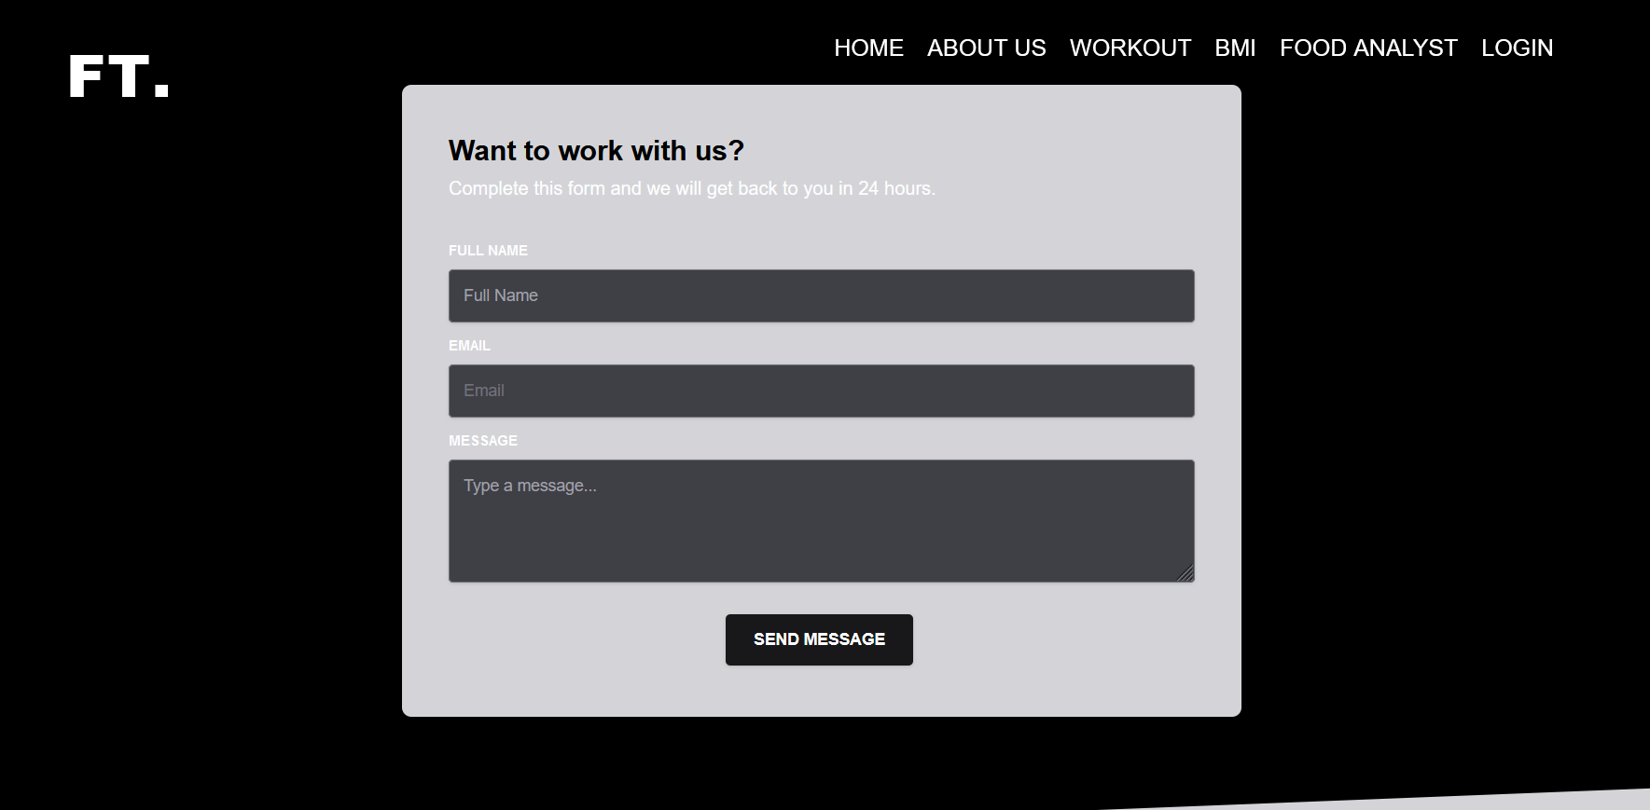
CONTACT US:

Slide 11
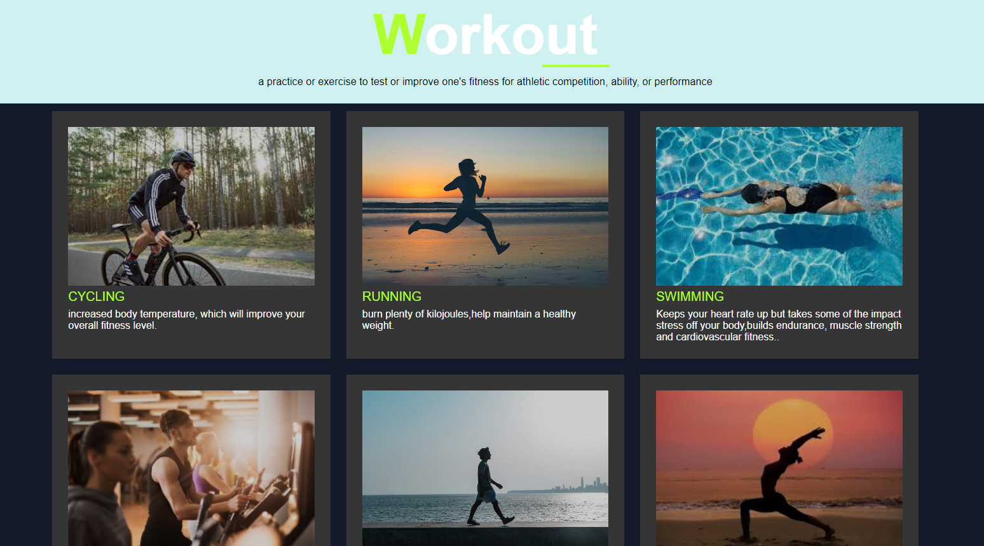
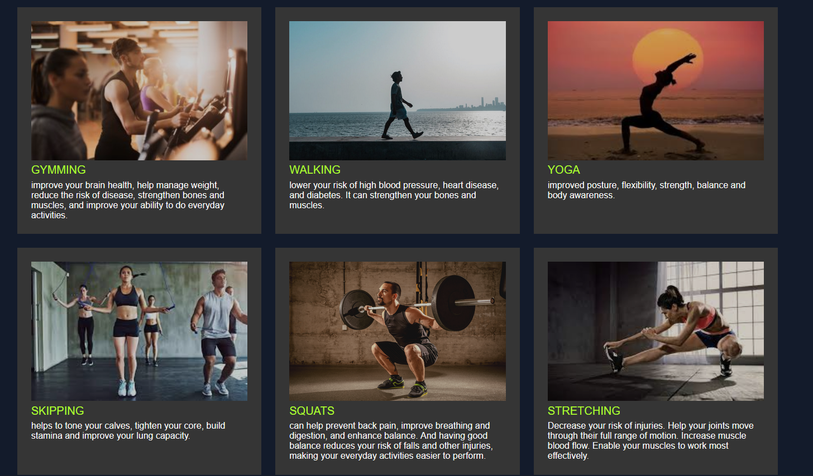

Slide 12
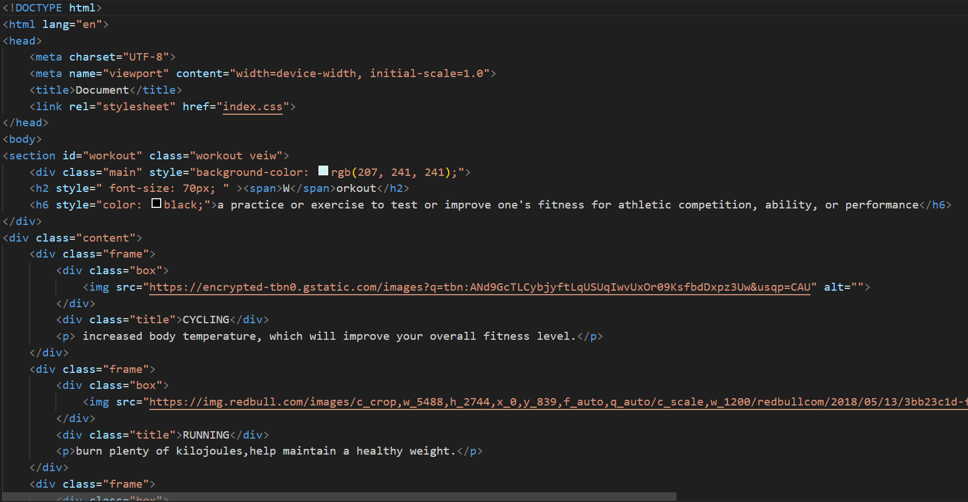

Slide 13
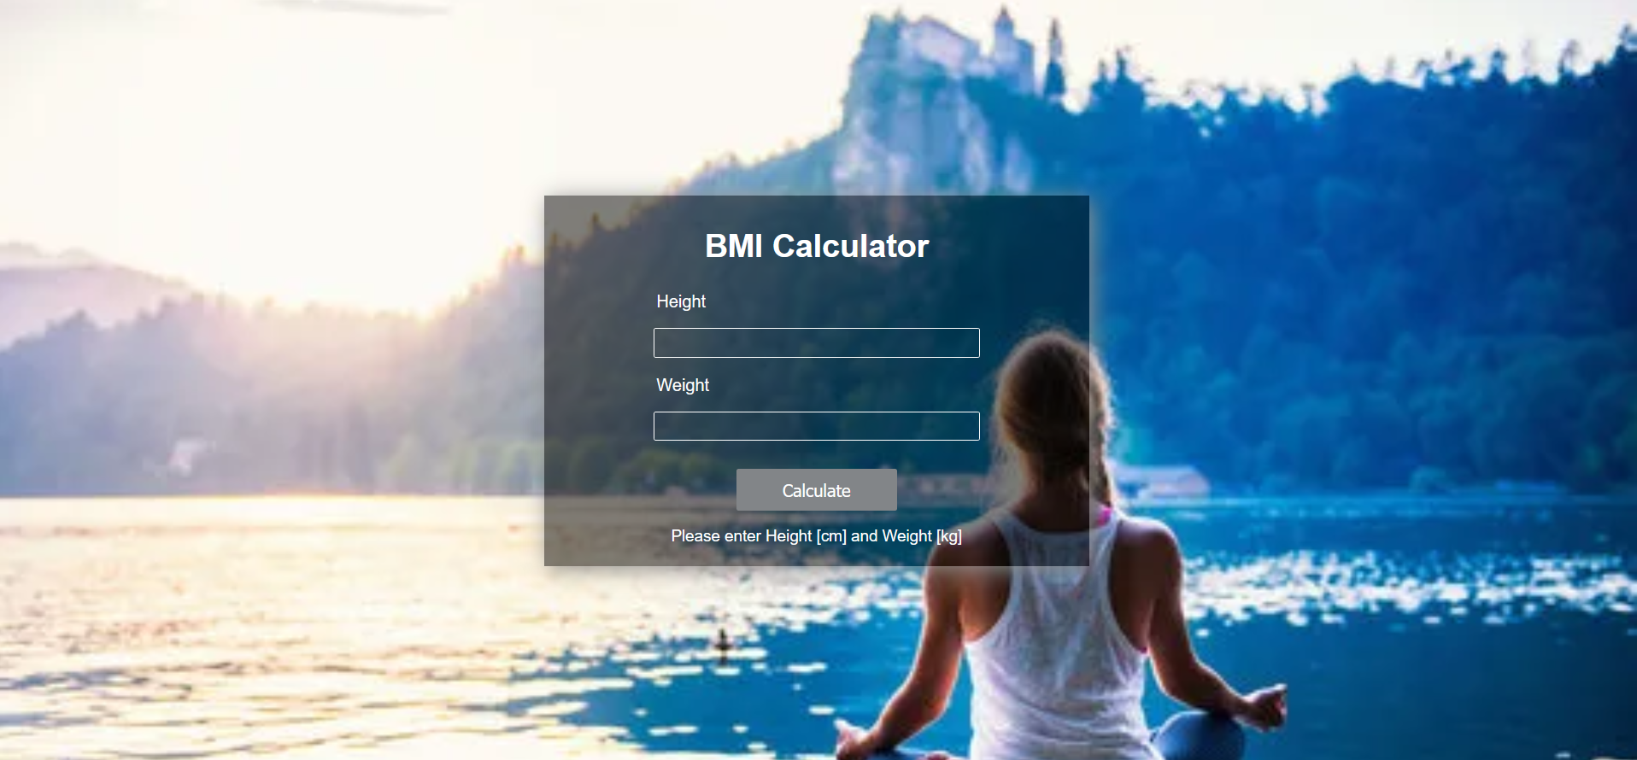

Slide 14
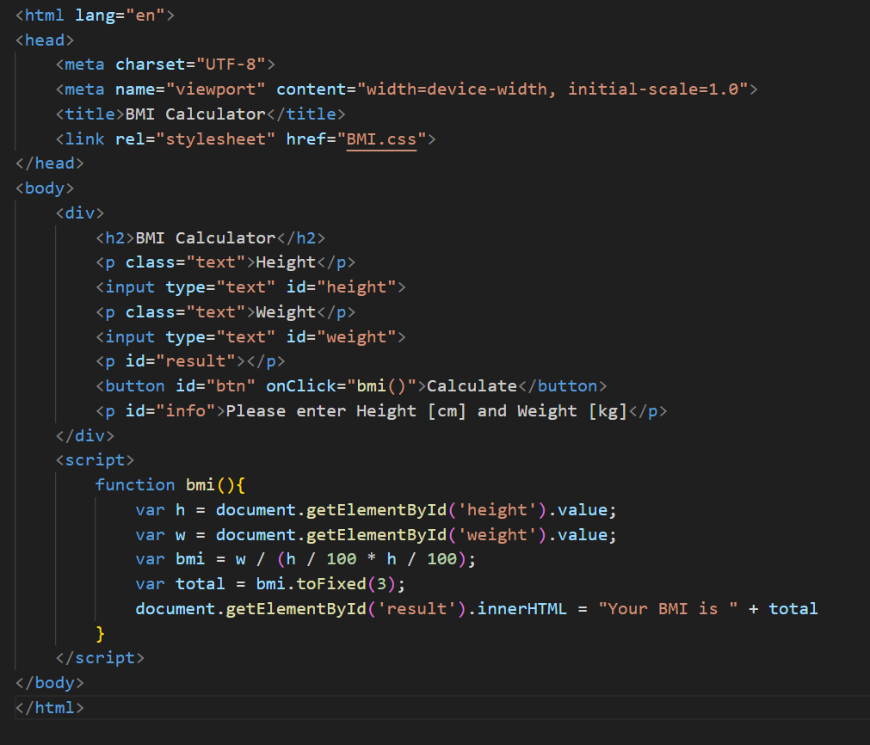

Slide 15
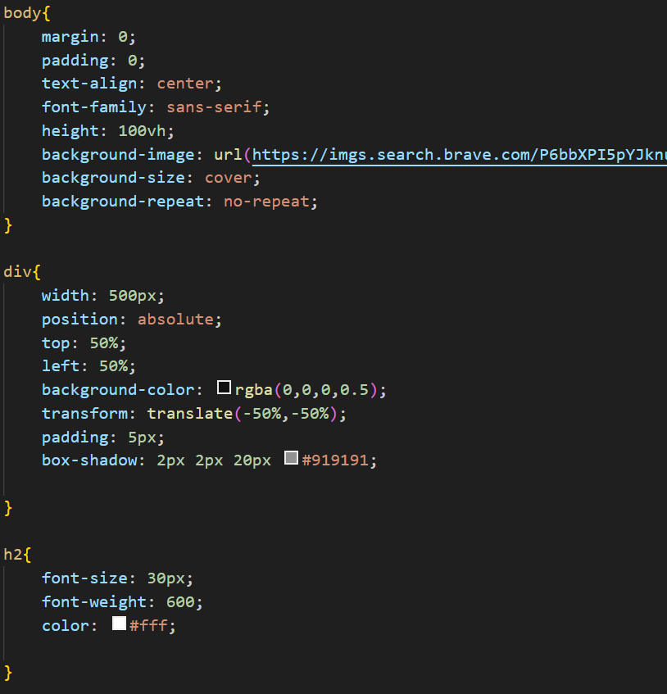
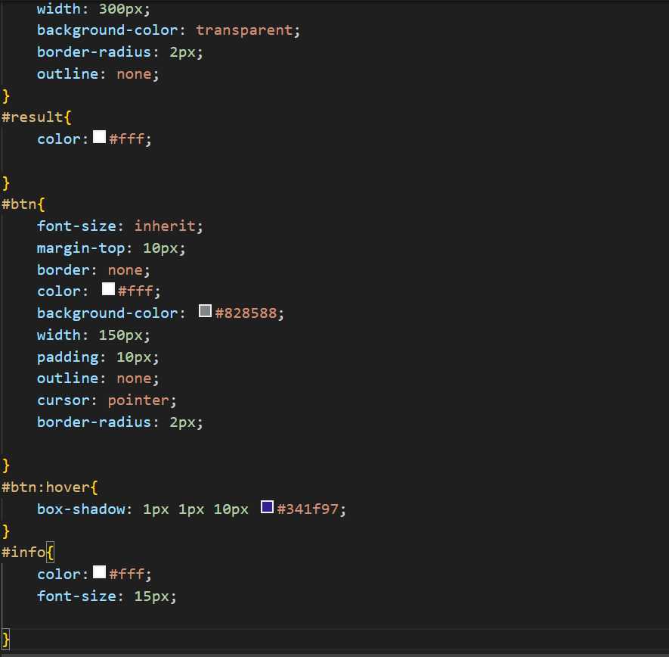

Slide 16
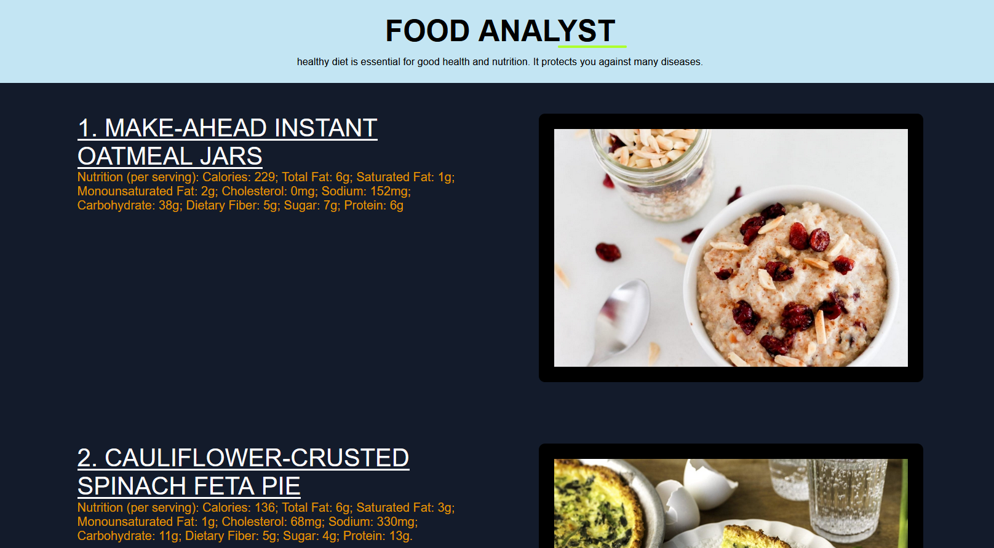

Slide 17
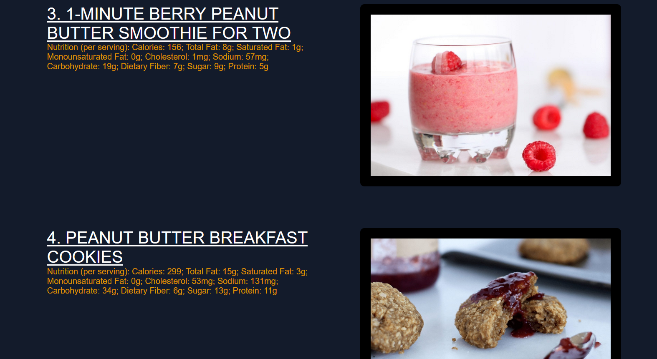

Slide 18
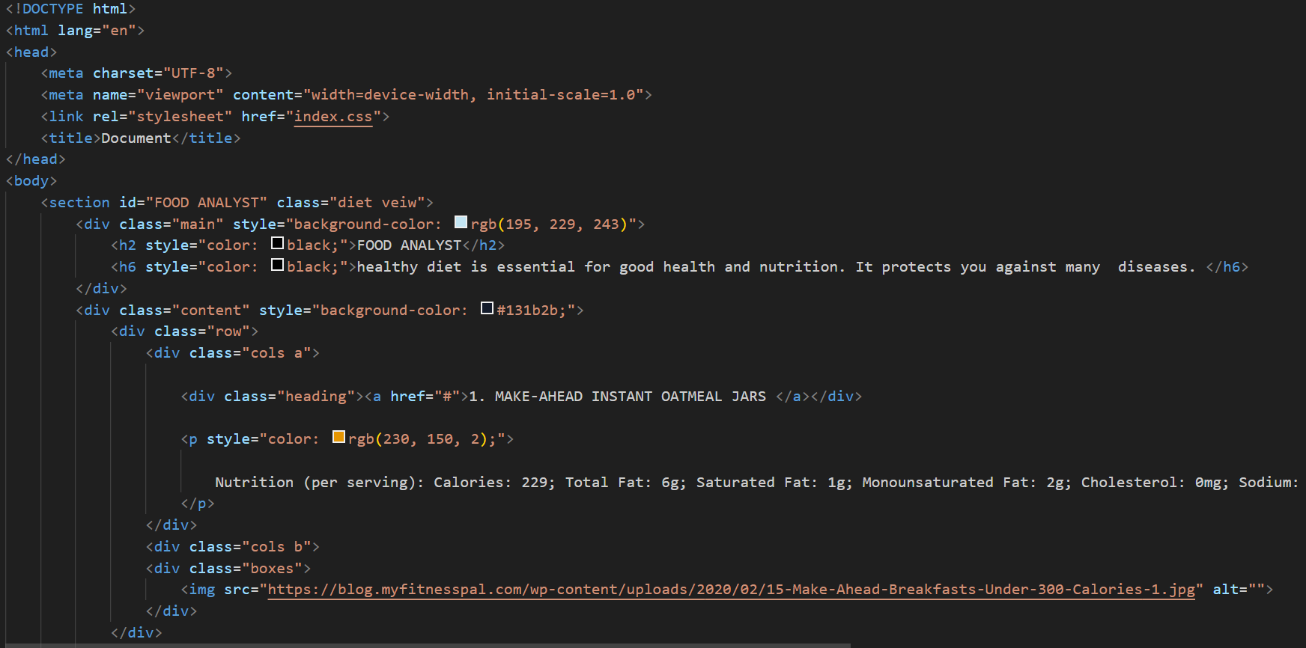

Slide 19
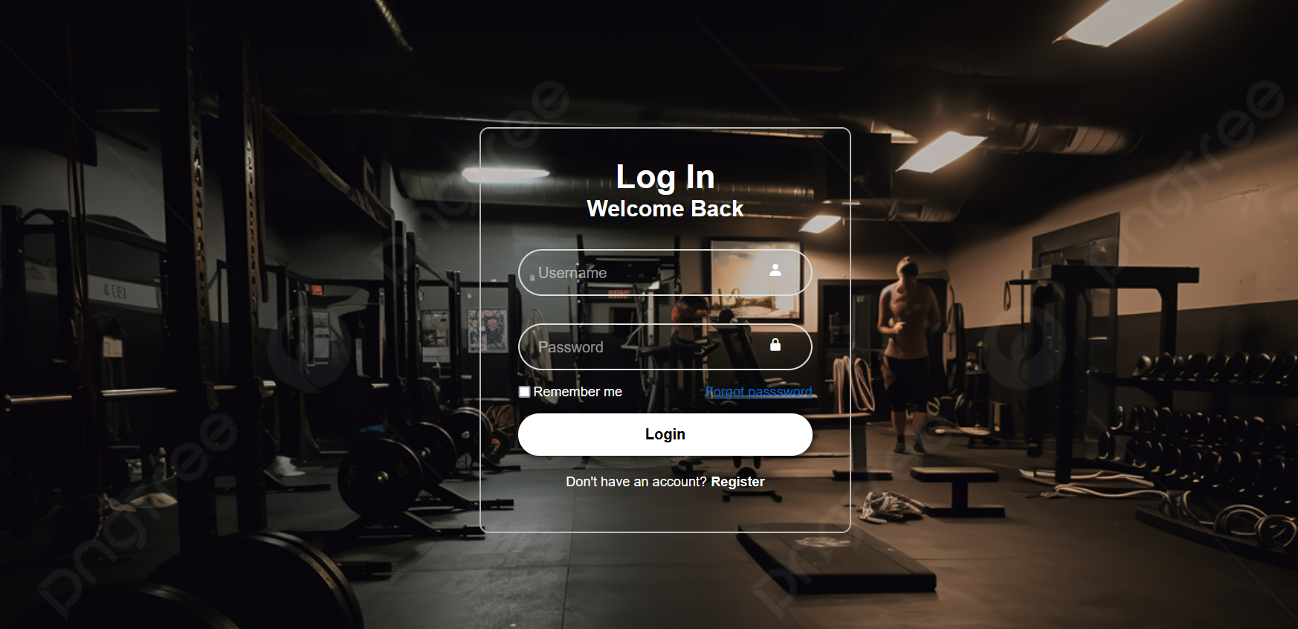

Slide 20
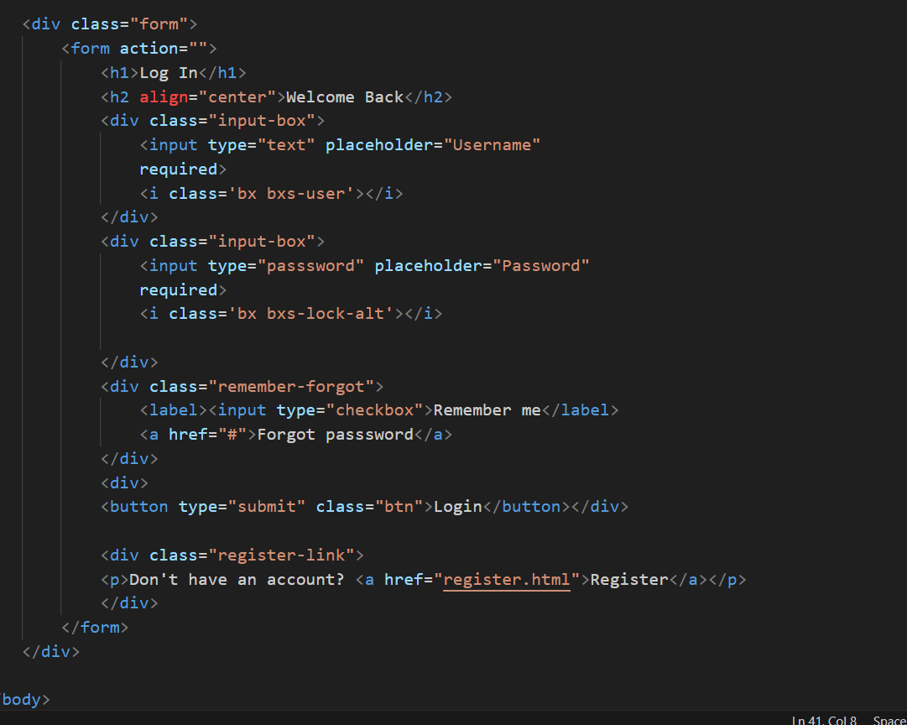

Slide 21
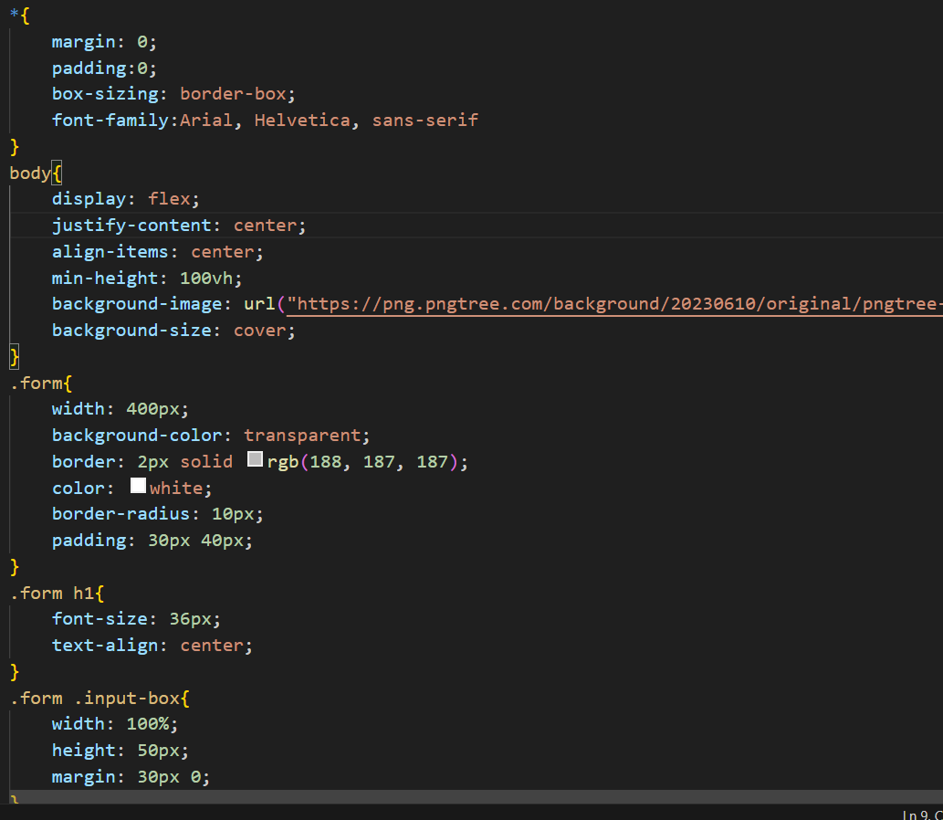
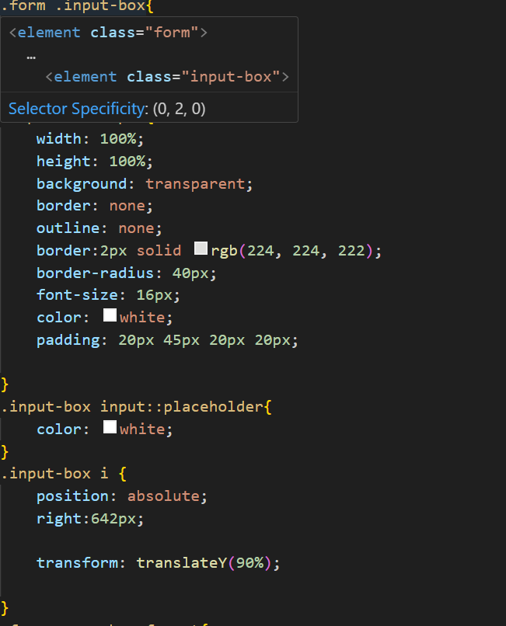

Slide 22
Conclusion
1.Project objective: Our goal to create a fitness tracker is to provide the user with instructions ,types of exercise, physical activity, nutritional programs.
2.Feature Development: We successfully implemented essential features such as login, specific nutritional diet, workout plans and more.
3.User-centered design: The platform’s user interface was designed with a focus on user experience.
PROJECT CONTRIBUTION:
Here in this project BMI ,Registration page, diet plan was done by Keshav.
HOME, About us, Workout plan and Login page was done by Khushi.

Slide 23
References/Links used
1.W3schools:
“HTML CSS and JAVASCRIPT documentation.” W3Schools,2023
We referenced this website extremely for HTML CSS and JAVASCRIPT syntax and best practices.
2. Dribbble :https://dribbble.com
We used Dribbble for idea of our project.

Slide 24


